Slide 1
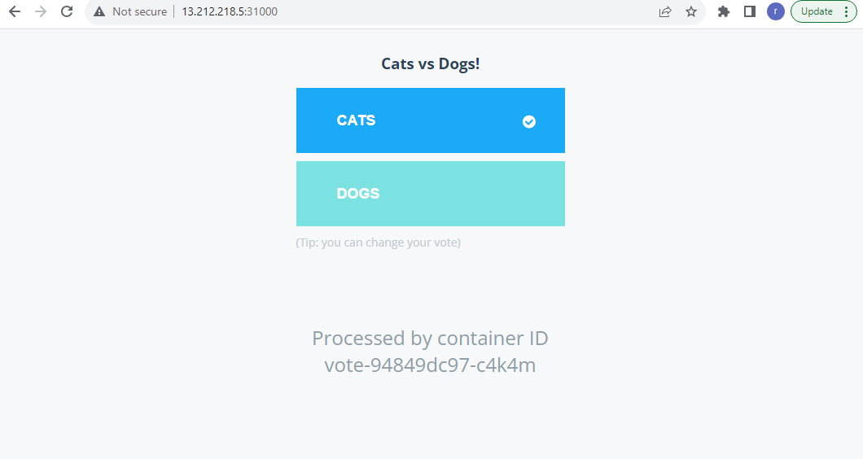
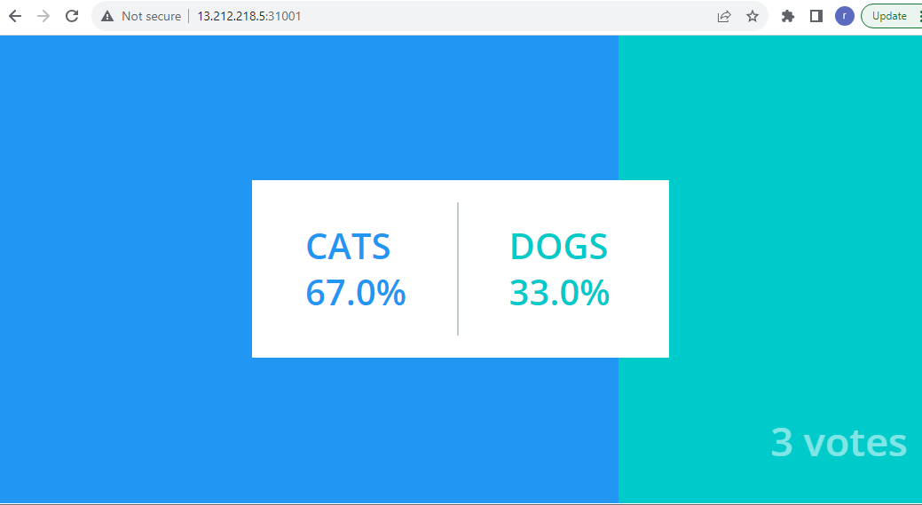
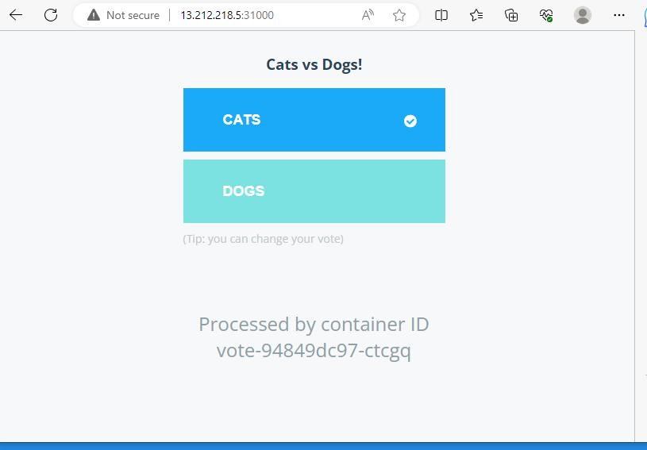
Voting App Assignment
Voting App Transaction Log
List of commands
1) kubectl delete all --all;
2) kubectl apply -f .
3) kubectl get all
4) kubectl get po -o wide
5) kubectl get po
6) kubectl get svc
7) kubectl delete po vote-94849dc97-c4k4m
8) kubectl delete po worker-dd46d7584-qc4z7
9) kubectl delete po db-b54cd94f4-bz7bq
10 ) kubectl logs worker-dd46d7584-qc4z7
11) kubectl scale deploy db --replicas=0
12) kubectl scale deploy db --replicas=1
After Voting App is deleted

Slide 2
Observations
1) All PoD's are created and came into running state with command "kubectl apply -f ."
2) I can access voting app web interface and results web interfaces through nodeport service & node IP address on 31000 && 31001
3) I have voted from three users and voting count is 3. screen shots are shared in PPT.
4) After voting PoD is deleted, I can see that voting application is still accessible. This is because replica set is defined as 1.
As replica set is defined in deployment yaml file. voting app PoD instance is launched again with different instance ID.
5) voting PoD got created again with instance ID "vote-94849dc97-ctcgq"
6) After worker Pod is deleted also there is no change in application behavior in voting & results windows.
7) Worker new instance got created. Vote count has same value as before worker PoD deleted.
8) similarly, after db PoD deleted, vote app & result app PoD's are still accessible.
db PoD instance created again with different instance ID. But it is observed that vote count reduced from 3 to 1. Not sure why it came down from 3 to 1.
9) Voting App & Results App functionality is not impacted.
10) when db PoD is stopped using command "kubectl scale deploy db --replicas=0". the pod went into terminating state and deleted from node.
11) Now I see votes count became zero in results app window. Even though I tried to vote from voting app the count is not incrementing in results app window.
12) I see voting & result PoD RESTART count is increased by 1. Not sure why ?
13) I have restarted db PoD using command "kubectl scale deploy db --replicas=1". Then after some time I see vote count is 2 which is previous count. It means when db PoD is stopped or terminated, results window does not vote count. After db PoD restarted only we can see vote count.

